Slide 1
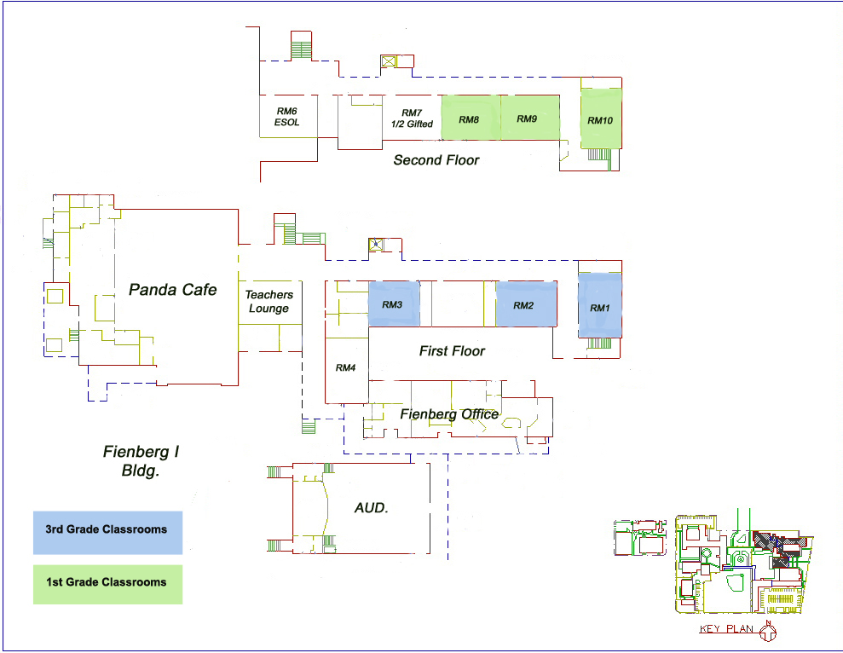
Española Way
Primary Exit in Red
Secondary Exit in Blue
Children of the World Park
Washington Ave.
14th Street

Slide 2
Española Way
Primary Exit in Red
Secondary Exit in Blue
Children of the World Park
Washington Ave.
14th Street

Slide 3
Española Way
Primary Exit in Red
Secondary Exit in Blue
Children of the World Park
Washington Ave.
14th Street

Slide 4
Española Way
Primary Exit in Red
Secondary Exit in Blue
Children of the World Park
Washington Ave.
14th Street

Slide 5
Española Way
Primary Exit in Red
Secondary Exit in Blue
Children of the World Park
Washington Ave.
14th Street

Slide 6
Española Way
Primary Exit in Red
Secondary Exit in Blue
Children of the World Park
Washington Ave.
14th Street

Slide 7
Española Way
Primary Exit in Red
Secondary Exit in Blue
Children of the World Park
Washington Ave.
14th Street

Slide 8
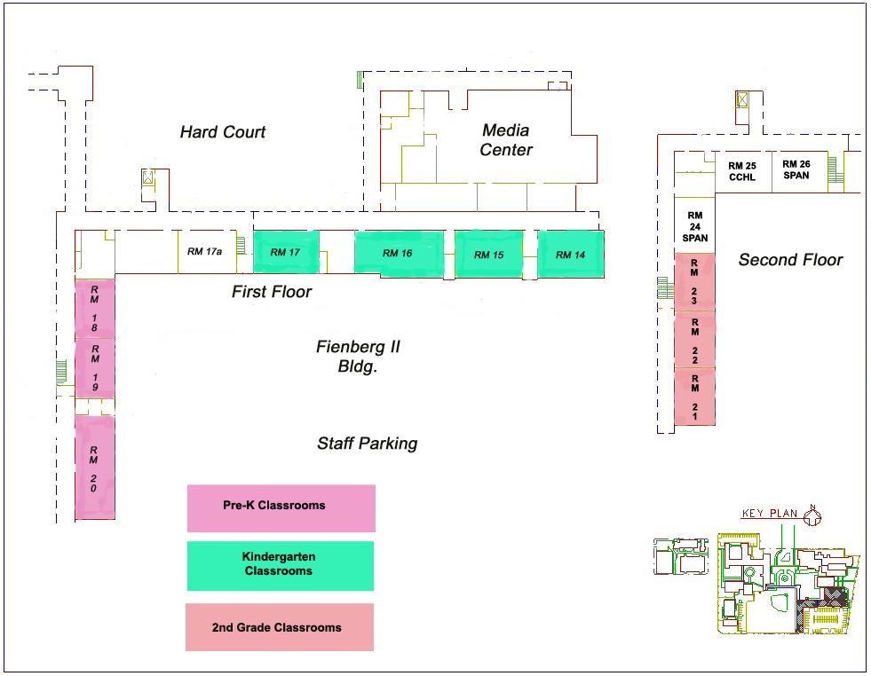
Primary Exit in Red
Secondary Exit in Blue
Española Way
Children of the World Park
Washington Ave.
5th Grade
14th Street

Slide 9
Primary Exit in Red
Secondary Exit in Blue
Española Way
Children of the World Park
Washington Ave.
5th Grade
14th Street

Slide 10
Primary Exit in Red
Secondary Exit in Blue
Española Way
Children of the World Park
Washington Ave.
5th Grade
14th Street

Slide 11
Primary Exit in Red
Secondary Exit in Blue
Española Way
Children of the World Park
Washington Ave.
5th Grade
14th Street

Slide 12
Primary Exit in Red
Secondary Exit in Blue
Española Way
Children of the World Park
Washington Ave.
5th Grade
14th Street

Slide 13
Primary Exit in Red
Secondary Exit in Blue
Española Way
Children of the World Park
Washington Ave.
5th Grade
14th Street

Slide 14
Primary Exit in Red
Secondary Exit in Blue
Española Way
Children of the World Park
Washington Ave.
5th Grade
14th Street

Slide 15
Primary Exit in Red
Secondary Exit in Blue
Española Way
Children of the World Park
Washington Ave.
5th Grade
14th Street

Slide 16
Primary Exit in Red
Secondary Exit in Blue
Española Way
Children of the World Park
Washington Ave.
5th Grade
14th Street

Slide 17
Primary Exit in Red
Secondary Exit in Blue
Española Way
Children of the World Park
Washington Ave.
5th Grade
14th Street

Slide 18
Primary Exit in Red
Secondary Exit in Blue
Española Way
Children of the World Park
Washington Ave.
5th Grade
14th Street

Slide 19
Primary Exit in Red
Secondary Exit in Blue
Española Way
Children of the World Park
Washington Ave.
5th Grade
14th Street

Slide 20
Primary Exit in Red
Secondary Exit in Blue
Española Way
Children of the World Park
Washington Ave.
5th Grade
14th Street

Slide 21
Primary Exit in Red
Secondary Exit in Blue
Española Way
Children of the World Park
Washington Ave.
5th Grade
14th Street

Slide 22
Primary Exit in Red
Secondary Exit in Blue
Española Way
Children of the World Park
Washington Ave.
5th Grade
14th Street

Slide 23
Primary Exit in Red
Secondary Exit in Blue
Española Way
Children of the World Park
Washington Ave.
5th Grade
14th Street

Slide 24
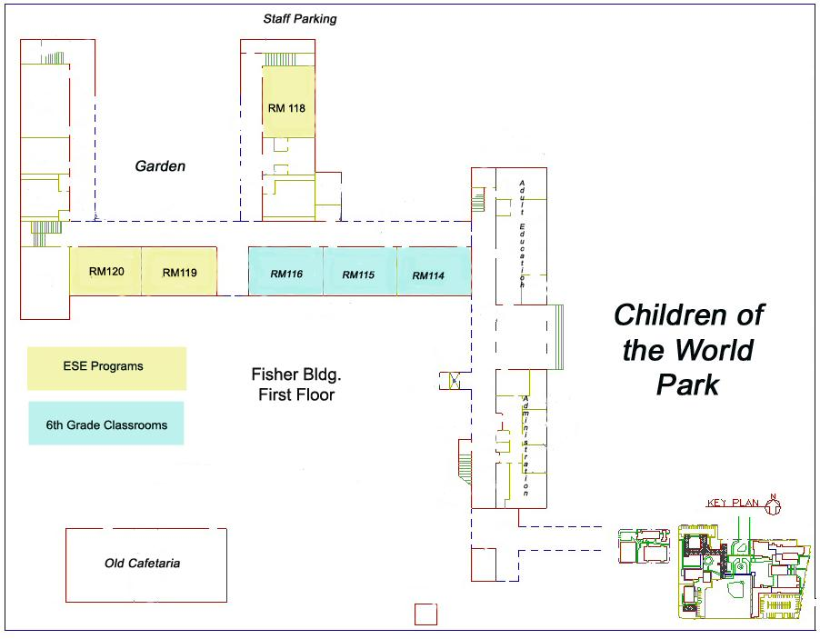
Primary Exit in Red
Secondary Exit in Blue
Española Way
Pennsylvania Ave.
KG Classrooms

Slide 25
Primary Exit in Red
Secondary Exit in Blue
Española Way
Pennsylvania Ave.
KG Classrooms

Slide 26
Primary Exit in Red
Secondary Exit in Blue
Española Way
Pennsylvania Ave.
KG Classrooms

Slide 27
Primary Exit in Red
Secondary Exit in Blue
Española Way
Pennsylvania Ave.
KG Classrooms

Slide 28
Primary Exit in Red
Secondary Exit in Blue
Española Way
Pennsylvania Ave.
KG Classrooms

Slide 29
Primary Exit in Red
Secondary Exit in Blue
Española Way
Pennsylvania Ave.
KG Classrooms

Slide 30
Primary Exit in Red
Secondary Exit in Blue
Española Way
Pennsylvania Ave.
KG Classrooms

Slide 31
Primary Exit in Red
Secondary Exit in Blue
Española Way
Pennsylvania Ave.
KG Classrooms

Slide 32
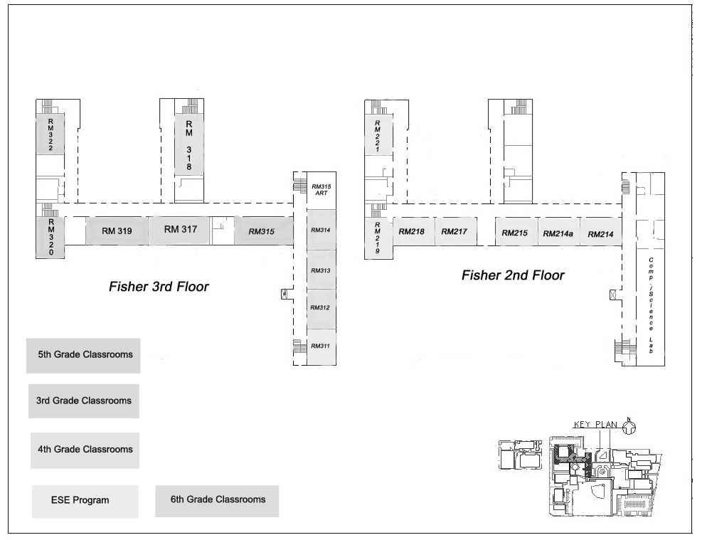
Primary Exit in Red
Secondary Exit in Blue
Española Way
Pennsylvania Ave.
Children of the World Park
Middle School

Slide 33
Primary Exit in Red
Secondary Exit in Blue
Española Way
Pennsylvania Ave.
Children of the World Park
Middle School

Slide 34
Primary Exit in Red
Secondary Exit in Blue
Española Way
Pennsylvania Ave.
Children of the World Park
Middle School

Slide 35
Primary Exit in Red
Secondary Exit in Blue
Española Way
Pennsylvania Ave.
Children of the World Park
Middle School

Slide 36
Primary Exit in Red
Secondary Exit in Blue
Española Way
Pennsylvania Ave.
Children of the World Park
Middle School

Slide 37
Primary Exit in Red
Secondary Exit in Blue
Española Way
Pennsylvania Ave.
Children of the World Park
Middle School

Slide 38
Primary Exit in Red
Secondary Exit in Blue
Española Way
Pennsylvania Ave.
Children of the World Park
Middle School

Slide 39
Primary Exit in Red
Secondary Exit in Blue
Española Way
Pennsylvania Ave.
Children of the World Park
Field
Middle School

Slide 40
Primary Exit in Red
Secondary Exit in Blue
Española Way
Pennsylvania Ave.
Children of the World Park
Field
Middle School

Slide 41
Primary Exit in Red
Secondary Exit in Blue
Española Way
Pennsylvania Ave.
Children of the World Park
Field
Middle School

Slide 42
Primary Exit in Red
Secondary Exit in Blue
Española Way
Pennsylvania Ave.
Children of the World Park
Field
Middle School

Slide 43
Primary Exit in Red
Secondary Exit in Blue
Española Way
Pennsylvania Ave.
Children of the World Park
Field
Middle School

Slide 44
Primary Exit in Red
Secondary Exit in Blue
Española Way
Pennsylvania Ave.
Children of the World Park
Middle School

Slide 45
Primary Exit in Red
Secondary Exit in Blue
Española Way
Pennsylvania Ave.
Children of the World Park
Middle School

Slide 46
Primary Exit in Red
Secondary Exit in Blue
Española Way
Pennsylvania Ave.
Children of the World Park
Middle School

Slide 47
Primary Exit in Red
Secondary Exit in Blue
Española Way
Pennsylvania Ave.
Children of the World Park
Middle School

Slide 48
Primary Exit in Red
Secondary Exit in Blue
Española Way
Pennsylvania Ave.
Children of the World Park
Middle School

Slide 49
Primary Exit in Red
Secondary Exit in Blue
Española Way
Pennsylvania Ave.
Children of the World Park
Middle School

